Slide 1
Advanced power bi project
Super market sales analysis

Slide 2
Steps for Creating Interactive Dashboard
1- Understanding of Project Objective
2- Analyse Data and then Data Cleaning
3- DAX Queries
4- Creating a Dashboard
5- Sales Forecasting
6- Learning Outcomes and Data Insights

Slide 3
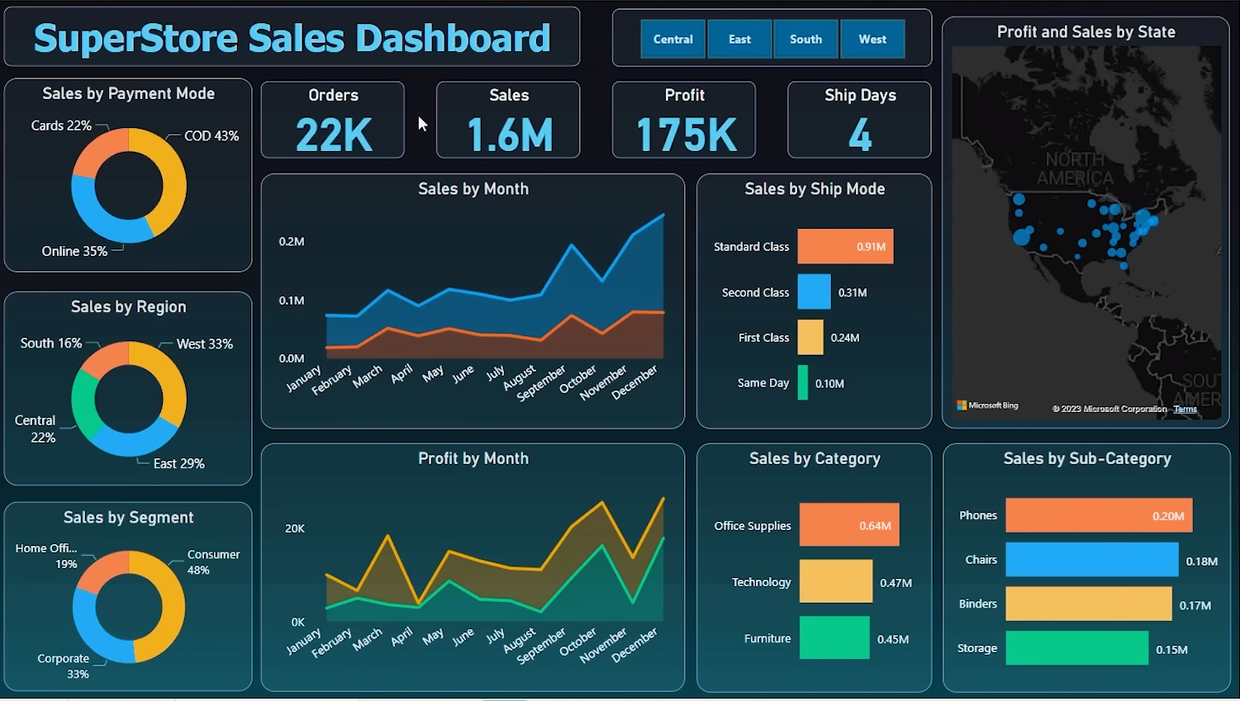
Project Overview

Slide 4
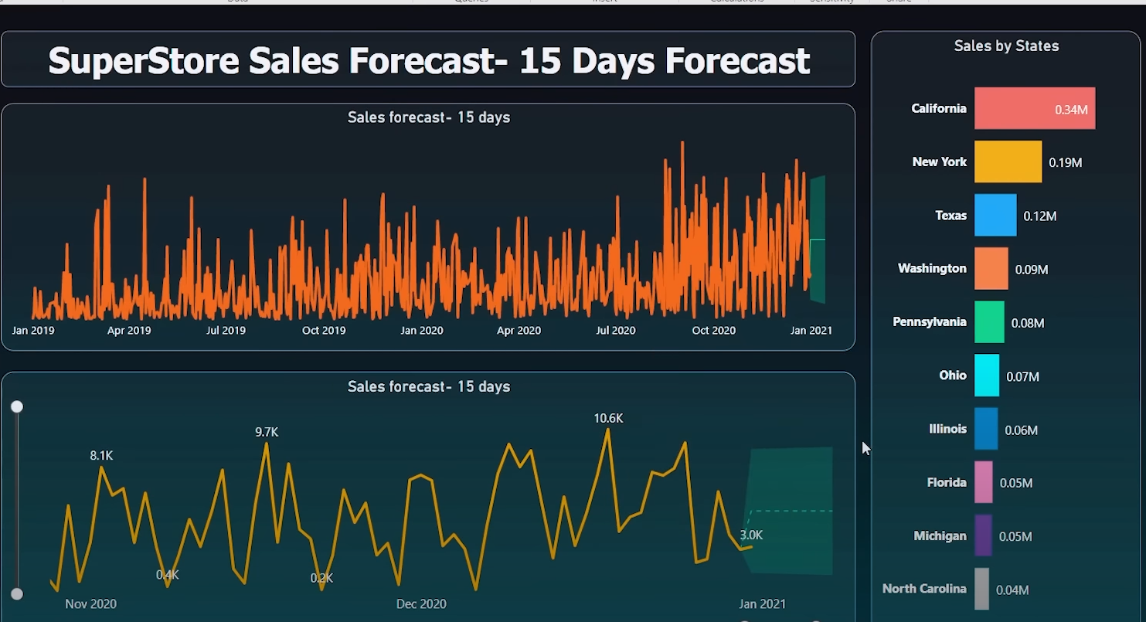
Sales Forecasting

Slide 5
Project Objective
To contribute to the success of a business by utilizing data analysis techniques, Specifically focusing on time series analysis, to provide valuable insights and accurate forecasting.

Slide 6
Description
The objective can be broken down into the following detailed components:
1- Dashboard Creation: Identify the KPIs, Design an interactive and visually appealing Dashboard, and add interactive visualization and filtering capabilities to allow users to explore the data at various levels of granularity
2- Data Analysis: Provide valuable insights to business entities regarding the effectiveness of their sales strategies through visualization and chart.
3- Sales Forecasting: Leverage historic data and apply time series to generate sales forecasts for the next 15 days.
4- Actionable insights and recommendations: The goal is to extract insights and actionable information that can drive strategic decisions and support the supermarket’s growth, efficiency, and satisfaction.

Slide 7
Learning Outcome
Incorporated Data Analysis Techniques, Specializing in Time Series Analysis, to deliver valuable insights, accurate sales forecasting, and interactive dashboard creation, Driving business success.

Slide 8
Thanks for the Time
By- Sushil Soni

